Slide 1
Chemical Oceanography Field Course
Determination of the nutrients, dissolved oxygen and chlorophyll A concentrations in Loch Etive
Lindsay Vare, Tim Brand, Richard Abell and Leah Morrison

Slide 2
Aim:
To identify and quantify the biogeochemical processes operating in Loch Etive and to explain them in relation to the physical mixing characteristics and environmental setting

Slide 3
Samples to be collected
At all Loch Etive stations you will collect:
1 nutrient sample from each depth
1 chlorophyll sample from each depth
In addition at RE5 and RE3 you will collect
3 oxygen samples from 4 depths (12 samples in total)
Also from other casts in the Firth of Lorne

Slide 4
Practical details
To determine the concentration of dissolved nitrate and phosphate using spectrophotometery
Determine calibrated CTD dissolved oxygen concentrations using the Winkler Titration method
Determine calibrated CTD chlorophyll fluorescence concentrations using laboratory extracted chlorophyll concentrations. Discuss chemistry data in relation to physical hydrography

Slide 5
The distribution of nutrients in Loch Etive
Inorganic nutrients are brought into the Loch from the sea and to a smaller extent from the surrounding rivers
The geographical and depth distribution in the Loch is then governed by circulation, extraction by phytoplankton in the surface waters and decay and remineralisation of phytodetritus and zooplankton material in the deeper waters.

Slide 6
Dissolved oxygen in Loch Etive
Oxygen in air 20.9% Oxygen in sea water: 0.00001%, 10ppm, 10mgl⁻¹ , 320μM at 100% saturation (surface N Atlantic water, temp 4.5C, 35psu)
Oxygen concentration decreases in water as salinity and temperature rise. So, warm seawater that is 100% saturated will have less oxygen than cold fresh water that is also 100% saturated
Oxygen concentration and saturation can increase during high levels of photosynthesis. Sometimes as high as 120%
Oxygen concentration and saturation decrease during high levels of bacterial decay of organic mater, termed ‘remineralisation’. This happens in the upper basin of Loch Etive.

Slide 7
Chlorophyll A and Phaeophytin A in Loch Etive
Phytoplankton require a source of dissolved carbon, light and nutrients to grow. Chlorophyll A is the main chemical that captures the light of the specific wavelength required for growth. (Blue and red light)
Chlorophyll A is measured to give an indication of the concentration of living phytoplankton in natural waters
Phaeophytin is measured to give an indication of the recently dead phytoplankton
In Loch Etive the main productivity (growth) period of phytoplankton is during late March and early April when light levels have become sufficient for photosynthesis and whilst there are high levels of nutrients in the surface waters, but productivity continues until October
In Loch Etive the dissolved organic compounds in the fresh water limits the amount of light that can penetrate the water and hence govern the depth distribution of the algae

Slide 9
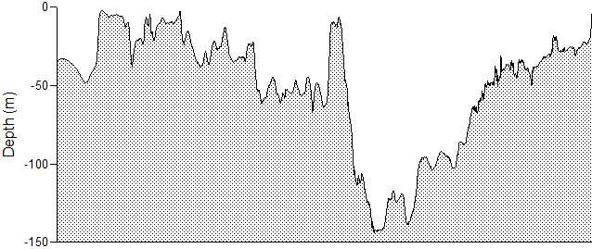
Circulation of Loch Etive
Flooding tidal marine water and ebbing modified water
River Awe fresh water (~60%)
River Etive fresh water (~40%)
Estuarine circulation
Fjordic circulation
Bonawe Sill, 18m deep
Depth penetration of marine water depends upon its density at Bonawe Sill
Salinity at 18m depth (psu)
~30
~20
0

Slide 10
The Loch Etive sampling stations
RE1 to RE5 Restricted (fjordic) circulation environment
RE9 & RE6 Estuarine circulation environment
RE8 Open coastal environment
Restricted Exchange
These stations were used during an 18 month sampling campaign during 1999 and 2000 called Restricted Exchange Environment Systems (REES) Program

Slide 11
Basic water properties-units
Salinity psu practical salinity units
Temperature ˚C degrees Celsius
Density, (mass/volume) derived from temperature, salinity and pressure
‘Sigma’, σ, density – 1000kgm⁻³
Density of seawater in Firth of Lorne:
~ 1026kgm⁻³ , σ = 26kgm⁻³
Density of freshwater
~1000kgm⁻³ , σ = 0kgm⁻³
Dissolved oxygen μM micro molar
Nutrients μM micro molar

Slide 12
The marine cycle of organic material, the ‘Biological Pump’
CO₂
Nut.s
O₂
CO₂
O₂
CO₂ + light + nutrients -> Org C + O₂
Phytoplankton productivity
sinking
Remineralization
Transport
O₂
O₂
CO₂
CO₂
CO₂
Remineralization
Nut.s
O₂
Retention
burial
CO₂
~ 2-50% of the pelagic production reaches the sea-floor
~1-3% of surface PP reaches the ocean seafloor, but in some shallow environments it can be up to 50%
Remineralization
Nut.s
O₂

Slide 15
More recently
In April-June (during the dry, sunny bit) there were repeated flushing events
We have had sufficient rainfall since July to isolate the upper basin
In June we had nearly constant values of temperature, dissolved oxygen and nutrients with depth ( O2: 260 uM, PO4: 0.3, NO3 1.5 uM)
We will be able to calculate the rate of increase/decrease of these parameters

